Slide 1
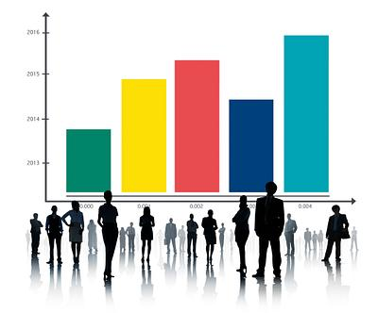

Optimizing Resource Allocation in Healthcare During the COVID-19 Pandemic from 2020 to 2023
By: Vickybhai Joshi(1811395)
To: Indu bala

Slide 2

Introduction
Industry Problem
During the COVID-19 pandemic, many challenges were faced by the healthcare industry, especially to allocate resources within the healthcare sector. Accurately allocating resources such as testing kits, medical personnel, and hospital beds was crucial to mitigate the impact of the COVID-19 pandemic.
Why is it important?
Critical resource management
Preventing healthcare facilities from becoming overwhelmed
Avoid resource shortages and waste
Better patient outcomes
Objective
Use descriptive and predictive analytics to identify the pattern of testing demand and predict future cases.

Slide 3
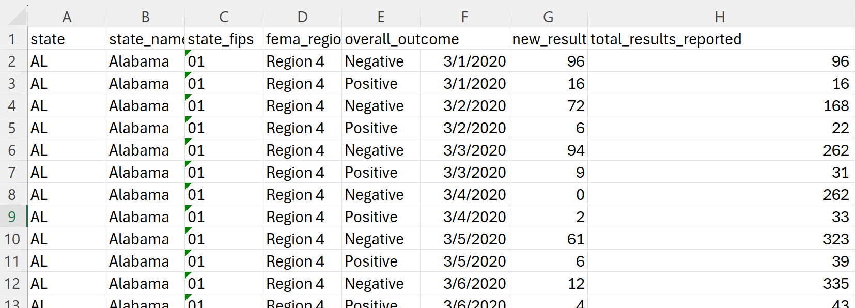
About Data and processing
The data shall be collected from ‘‘Healthdata Gov” due to its reliability in providing health-related information.
Data Link: https://healthdata.gov/dataset/COVID-19-Diagnostic-Laboratory-Testing-PCR-Testing/j8mb-icvb/about_data
Number of Columns: 9
Number of Rows: 242971
Data Processing:
Original data have “geocoded_state ” collum but there is no data available so, first removed it.
Change the data type of “date” column
Snapshot of dataset

Slide 4
Description of Methodology
Utilized descriptive analytics to identify patterns in COVID-19 test results across different regions and outcomes[5].
Applied predictive analytics using exponential smoothing to forecast future COVID-19 cases and testing demand.
Visualized trends and regional variations using Tableau for effective decision-making in resource distribution and public health management[6].

Slide 5
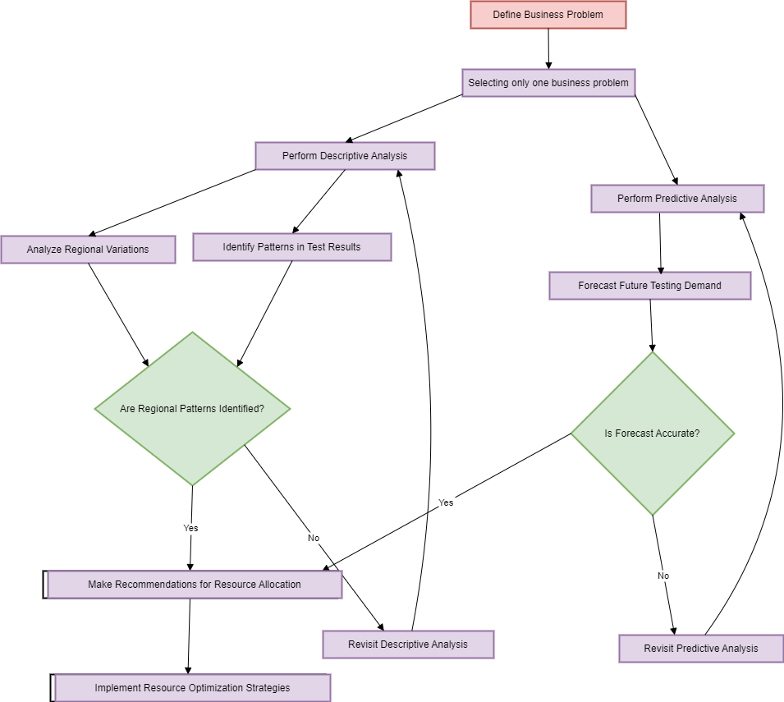
Flowchart
Source: Smart draw[7]

Slide 6
Analytical methods and Used data
Exponential Smoothing: A predictive analytics technique used to forecast future values, emphasizing more recent observations for trend identification [1].
Descriptive Analytics: Used to create visualizations such as charts and graphs to summarize and describe the COVID-19 testing data across regions.
The predictive model uses historical COVID-19 test results in data, including daily new and total results categorized by the outcome and FEMA region, to forecast future testing demand and trends[1].

Slide 7
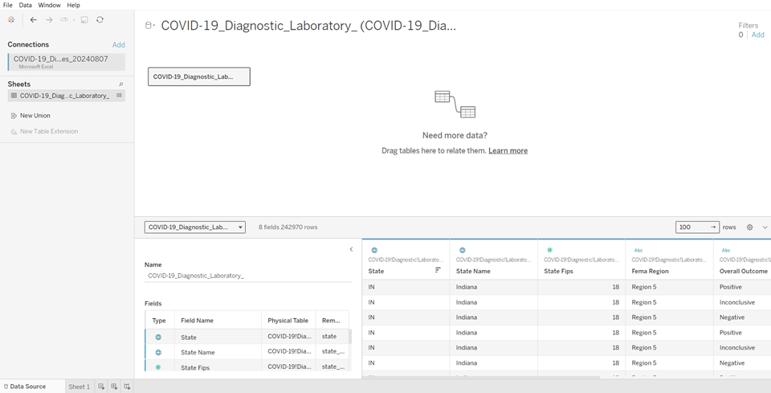
Data Input and Output
Input
Output
To input data in Tableau, open Tableau Desktop, click on "Connect," select data source Excel, and load the data.
The outcome is a detailed analysis of COVID-19 testing resource optimization, including trends and patterns in test results, to better manage resource allocation and improve public health responses.

Slide 8
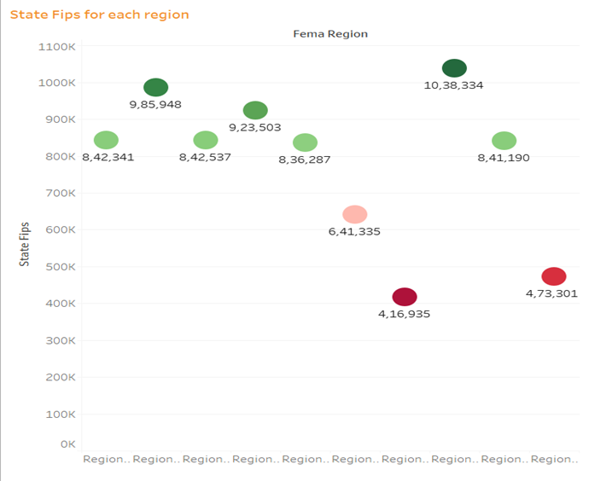
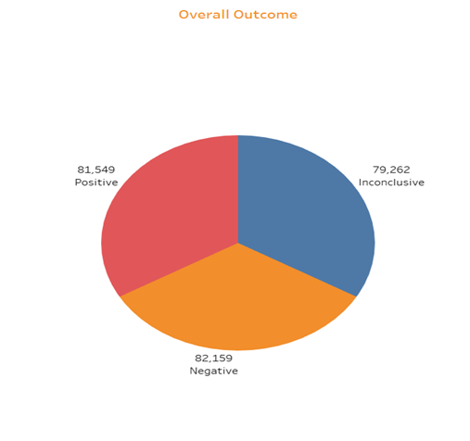
Descriptive Analytics
For descriptive analytics, making different types of charts and interpreting these charts as per selected business problem[8].
The above pie chart shows the total outcomes over the “Covid-19 Diagnostic laboratory”.
This bubble chart shows the region-wise state fips. Region 8 has the highest number of states and region 7 has minimum states.

Slide 9
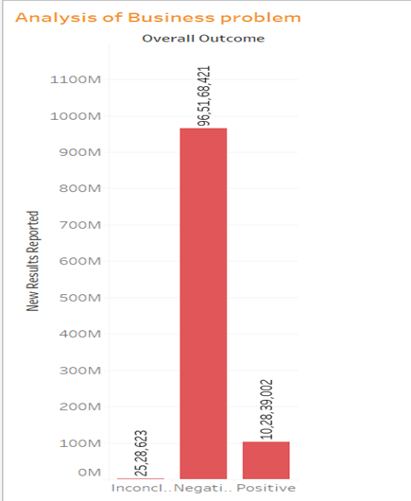
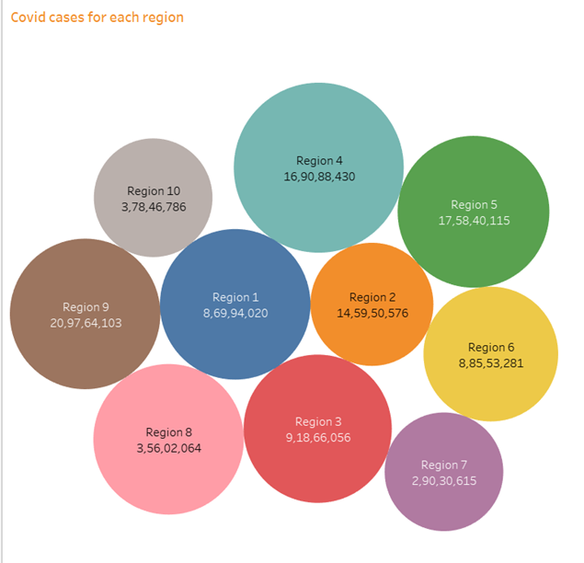
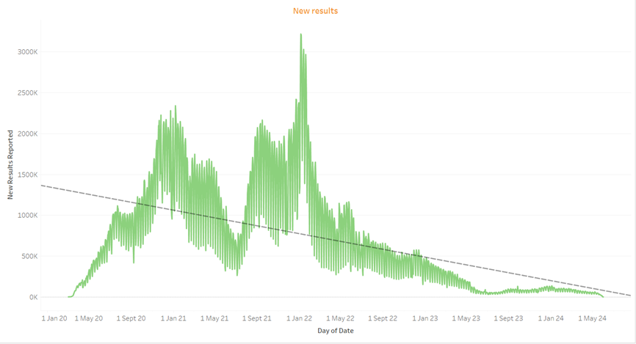
This bar chart shows the distribution of “Overall outcome” by new results reported. This chart shows that the trend of the results is decreasing showing the positive effect on the workforce and kits of the COVID-19 warriors[6].
The bubble chart illustrates COVID-19 case distributions across FEMA regions with bubble size indicating case volume. Region 9 has the highest case count then Region 5 and Region 4. While Region 7 has the lowest number of cases. This visual representation helps identify regions with the highest and lowest case burdens that is guiding targeted resource allocation and public health interventions[4].
This chart shows that the trend of the results is decreasing showing the positive effect on the workforce and kits of the COVID-19. Such insights can inform future resource allocation and public health strategies, ensuring that testing and medical support are adjusted in response to evolving case trends[3].

Slide 10
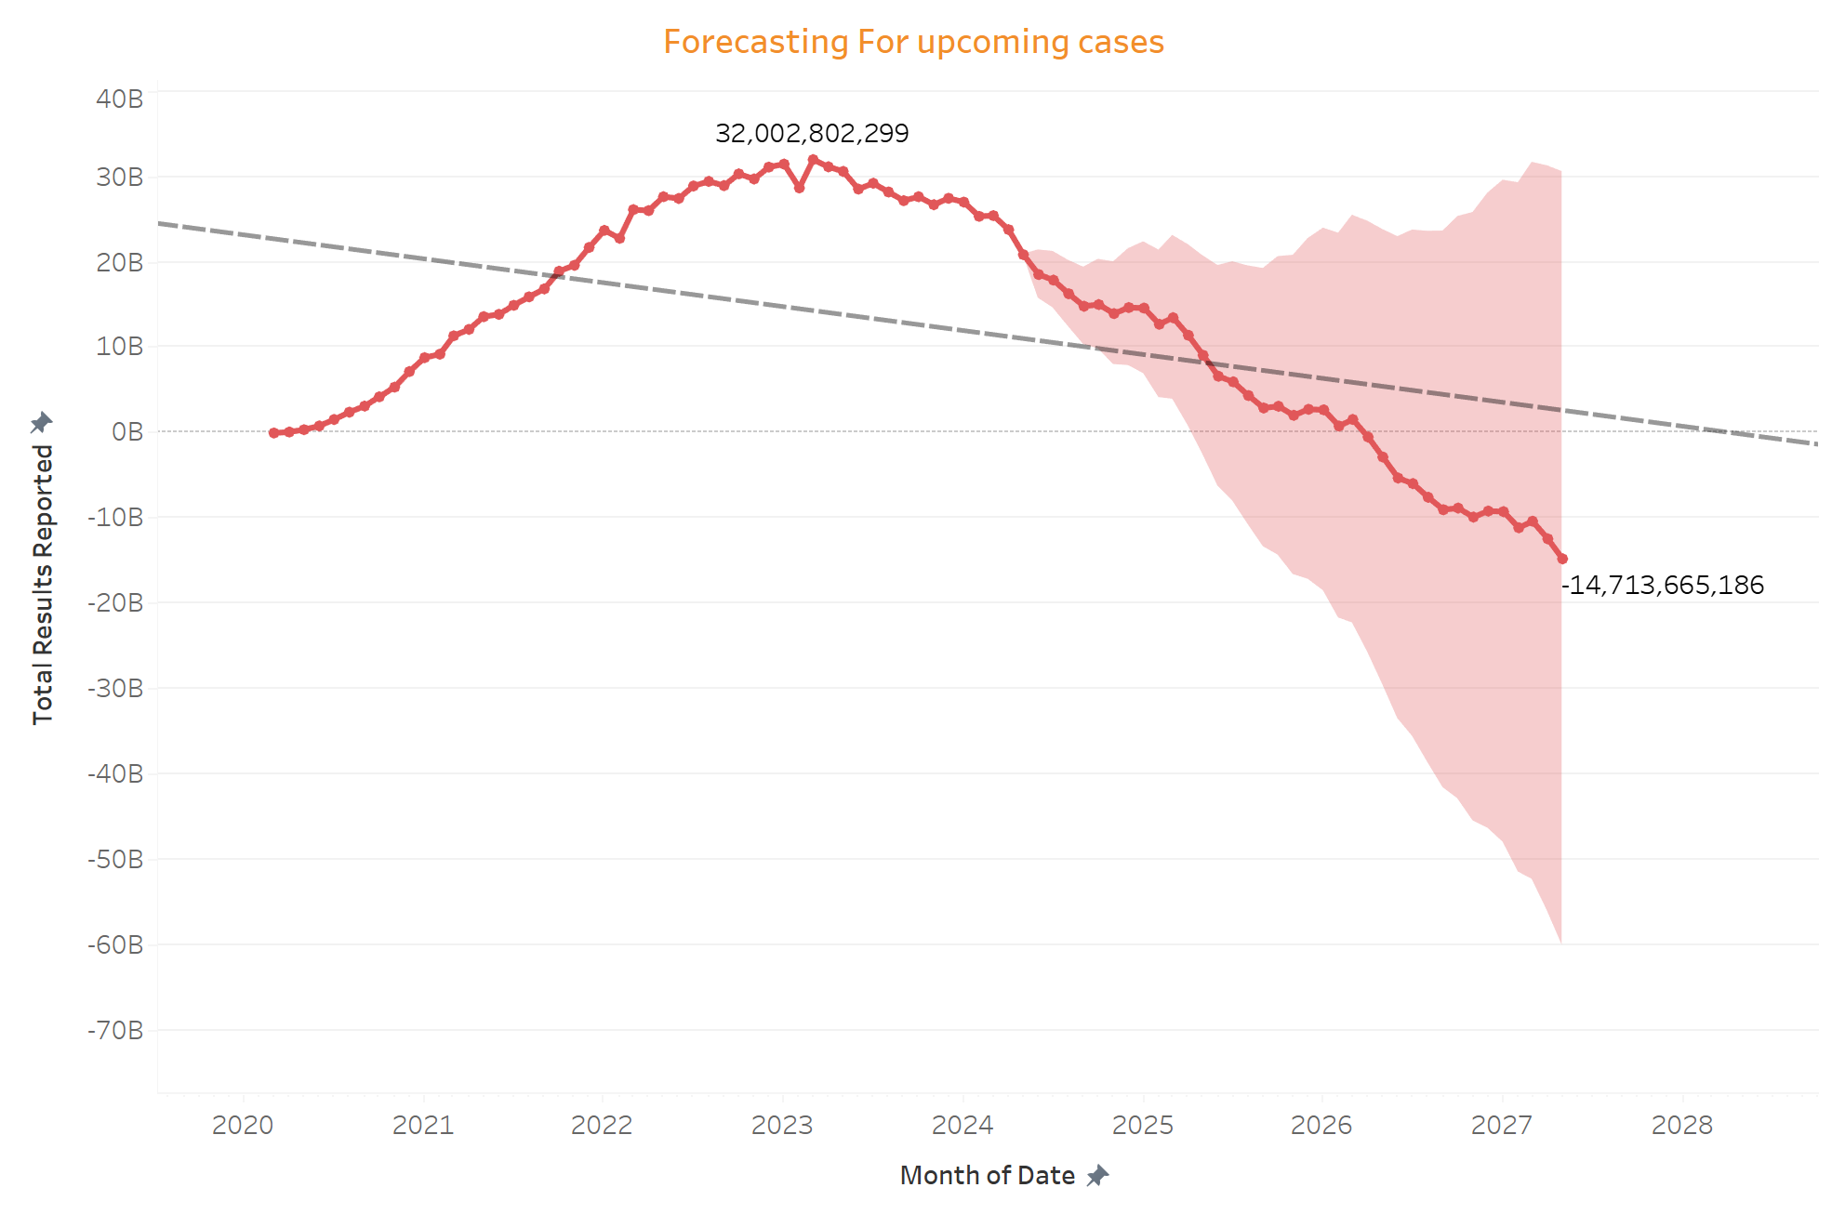
Predictive Analytics
The exponential smoothing model is used for predictive analysis by using Tableau[2]. It contributes to the efficient allocation of resources, and effectiveness in carrying out tests and is also prepared to deal with shifting requirements[9].

Slide 11
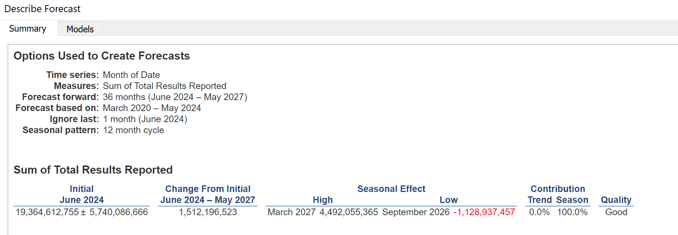
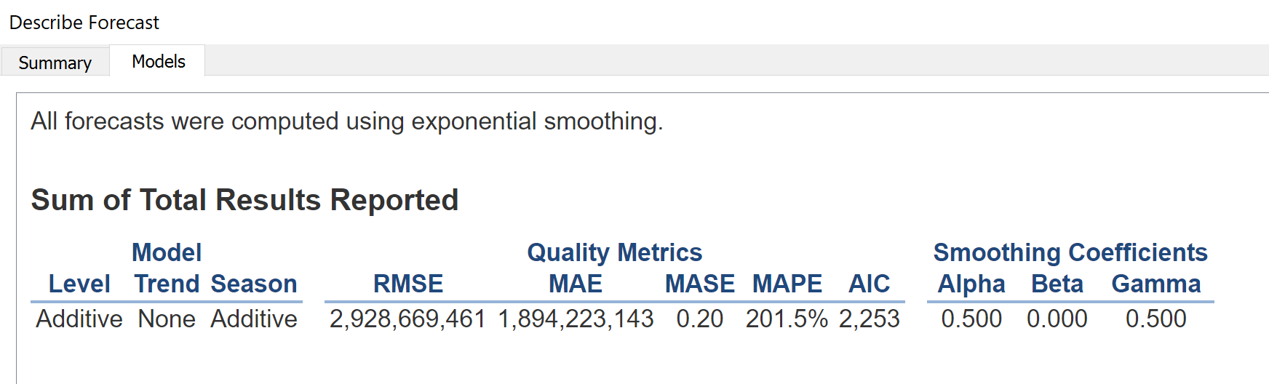
Model Summary and Accuracy

Slide 12

Reflection of techniques and software
Efficacy: Tableau incorporates trends and distributions enhancing the understanding of the results of tests and distribution of resources.
Enhancements: The use of such models could predict future test volumes and case trends in future. Including the other variables like demographic or geographical could help to enhance the actionable resource allocation.

Slide 13

Peer discussion
Objective: Optimize COVID-19 testing resources using descriptive and predictive analytics.
Positive Feedback: Clear business question, reliable data source.
Constructive Feedback: Expand on public health policy impacts, address data accuracy and timeliness, and consider advanced forecasting techniques.
Recommendations: Integrate additional data, explore hybrid models and extend analysis to other healthcare issues.

Slide 14
Results and insights for business problem
Regional Resource Needs: Regions with high case counts (e.g., Region 9) require more resources and targeted interventions.
Testing Efficiency: Negative results dominate, indicating effective testing; the decreasing trend in new results reflects successful interventions.
Resource Allocation: Adjust kits and personnel based on case trends and regional variations for optimized resource distribution.
The model highlights regions with rising or falling case counts, enabling efficient resource allocation and improving response strategies for COVID-19 testing and management.

Slide 15
Role limitations and recommendations:
Role: There is a way of exponential smoothing where the trends determinable from prior data help in the forecast of future testing requirements and therefore resources.
Limitations: It may have problems with the adaptation to changes in trends and does not include factors from outside and real-time data as well as seasonality.
Recommendations:
They should incorporate more complex forecasting methods such as ARIMA for accuracy enhancement or even machine learning techniques with more accurate and long term data.
Take real or actual time data and other factors like demographics to increase model accuracy.

Slide 16
Reference
Community. tableau 2024, Tableau Community Forums, Tableau.com, viewed 29 August 2024, <https://community.tableau.com/s/question/0D54T00000C6V3USAV/step-by-step-forecast-in-tableau>.
Help.tableau 2017, How Forecasting Works in Tableau, Tableau.com, viewed 27 August 2024, <https://help.tableau.com/current/pro/desktop/en-us/forecast_how_it_works.htm>.
‌Help.tableau 2018, Build a Basic View to Explore Your Data, Tableau.com, viewed 29 August 2024, <https://help.tableau.com/current/pro/desktop/en-us/getstarted_buildmanual_ex1basic.htm>.
help.tableau 2024, Visual Best Practices, Tableau.com, viewed 27 August 2024, <https://help.tableau.com/current/blueprint/en-us/bp_visual_best_practices.htm>.
Investopedia 2024, Descriptive Statistics: Definition, Overview, Types, and Examples, Investopedia, viewed 29 August 2024, <https://www.investopedia.com/terms/d/descriptive_statistics.asp>.
‌Investopedia 2024, Predictive Analytics: Definition, Model Types, and Uses, Investopedia, viewed 29 August 2024, <https://www.investopedia.com/terms/p/predictive-analytics.asp>.
Smartdraw 2024, How to Make a Flowchart - Create a Flowchart with the Help of this Flowchart Tutorial, Smartdraw.com, viewed 29 August 2024, <https://www.smartdraw.com/flowchart/how-to-make-a-flowchart.htm>.
Tableau 2016, Data Is Beautiful: 10 Of The Best Data Visualization Examples From History & Today, Tableau, viewed 27 August 2024, <https://www.tableau.com/learn/articles/best-beautiful-data-visualization-examples>.
‌Tableau 2024, A Guide To Predictive Analytics: Definition, Importance, and Common Techniques, Tableau, viewed 29 August 2024, <https://www.tableau.com/learn/articles/what-is-predictive-analytics>.
‌Tableau 2024, What Is Data Visualization? Definition, Examples, And Learning Resources, Tableau, viewed 29 August 2024, <https://www.tableau.com/learn/articles/data-visualization>.

